Slide 1
Blockchain Related
two interesting applications we’ve built
Group 7

Slide 2
First App

Slide 3
Problem
Centralized server with only one replica of chain has a problem of security.
If the central server is hacked, then it can revise the accounting information to whatever it is wanted to be.
So we should need to distribute the trusts.

Slide 4
Approach
Implement a simulator that simulates the process of encryptions and verifications.
Derive interesting extensions based on the simulator

Slide 5
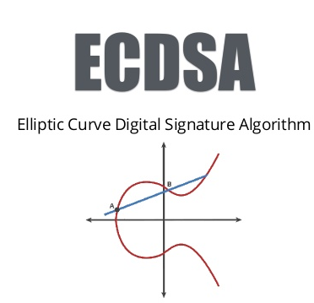



First of all…...bitcoin simulator
Frontend communication: GUI + Socket Programming for broadcasting
Backend chain implementation:
Basic cryptography and our NP Complete problem utilities

Slide 6
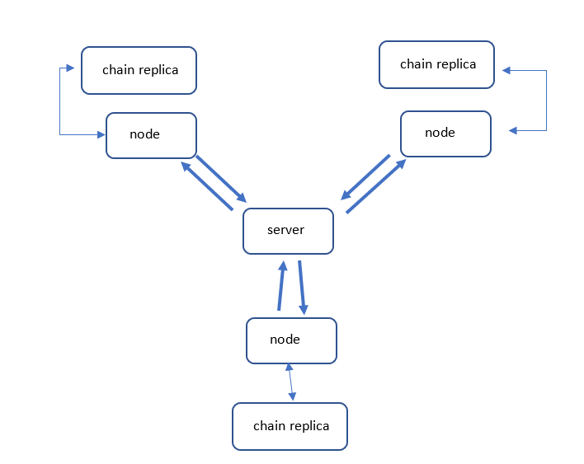
Abstract structure

Slide 7
Distributed Chain for accounting
Each client has their own distributed chain.
The one with the longest length (total computing power) will be counted as the valid chain. Client will replace the chain with the longest chain after each broadcast themselves.
The transaction messages are encrypted with RSA or ECDSA signature signed by private keys, and other clients can verify the mined new block or transaction message, putting them into their own distributed accounting chain.

Slide 8
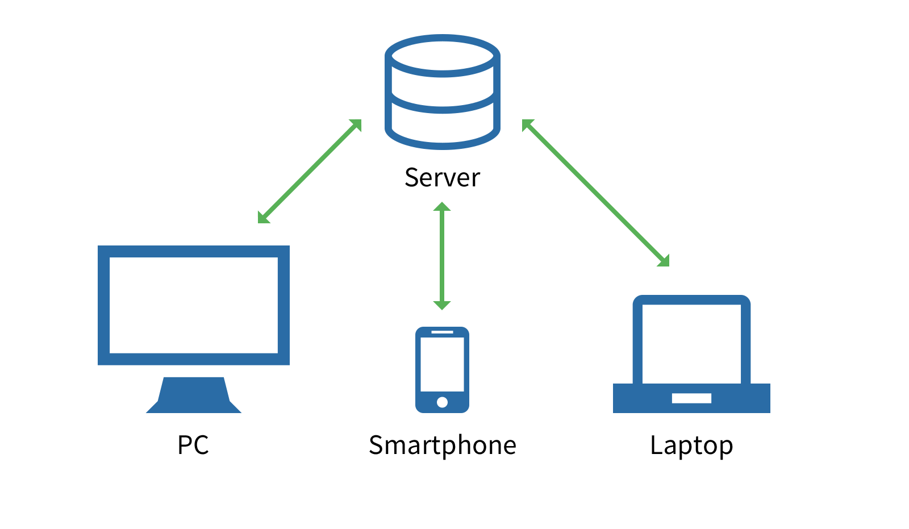


A special server-client Model
Server: A hub broadcasting and redirect messages or transactions
No authorities, Zero Computations, Timer Thread Synchronization
Client nodes: computation + verification
Replica of chain for each client
Port: x
Port: x
Port: x

Slide 9


Server
Guys I found a new block
Notes:
This is what proposing stage looks like

Slide 10
Server
See I’m not lying
A block has been verified! Time to lock the session and wait for the next one!
Verified!
Verified!
Notes:
And this is verification stage. Once verified, the session would be locked until the session’s countdown is over.

Slide 11
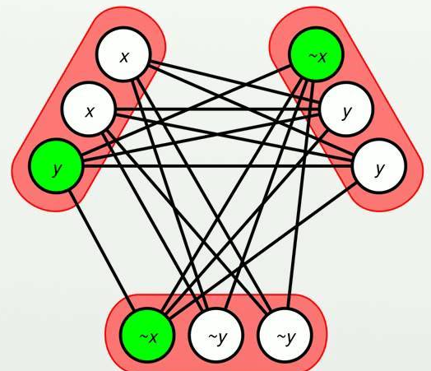
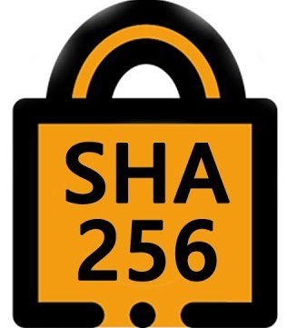
An extra mining mechanism…...
Lower difficulty of original mining, and solve an extra NP Complete Problem
Feature: Hard to solve but easy to verify
Purpose: Contribute part of computing power to more practical problems
We use: Boolean SAT Generator and Solver
Now I need to solve two problems for a new block!
I’m hard to solve but easy to verify!
Just like me!

Slide 12
Format of Overall Broadcast Messages
Mined new block: UTF-8 Encoded String
Miner’s public address + ‘$’ + nonce + ‘@’ + SAT problem + ‘@’ + SAT answer
(There won’t be any ‘$’ or ‘@’ within public address since it’s Distinguished Encoding Rules (DER) format of public key in this case)
Transaction: UTF-8 Encoded String
Transaction broadcast payload will be: transaction message + '$' + sender public key+ '$' + signature. Transaction message will have the infos of receiver’s public address and the amounts of transfer.

Slide 13
Experimental Results
Both payloads of mining and transaction broadcasts show the system is working correctly
More details can be found in our final presentation video:
https://www.youtube.com/watch?v=BPb8Sc9wiP4

Slide 14
Second App

Slide 15
Problem
Growing adoption of smart contracts on blockchains poses new security risks, as writing increasingly complex decentralized programs is error-prone. To address this issue, we designed and implemented a compositional verification framework for verifying the correctness of industry-grade blockchain applications.

Slide 16
Challenges
Existing works, which aim to formally analyze the correctness of blockchain execution semantics, are facing three challenges.
1. The lack of support for the precise verification of strong correctness guarantee for user-defined and contract-specific properties. Previous work on security pattern matching, symbolic execution, and model checking, although effective for well-understood vulnerabilities such as re-entrancy and mishandled exception, cannot be used to prove contract-specific functional properties specified by developers, such as requiring a linked list to be sorted. These techniques are also challenged by false positive results, rendering verification ineffective.

Slide 17
2. Existing techniques are not capable of dealing with the increasingly diverse smart contract ecosystem. All previous approaches either focused on Solidity (the official high-level language of Ethereum smart contracts) such that no formal guarantees can be provided (due to a lack of formal semantics of Solidity), or focused on the Ethereum virtual machine (EVM) bytecodes that restrict the expressiveness of specification and the transferability of the proofs to other target backends.
3. The last challenge is usability. Specifically, existing frameworks offer very limited ways for users to reduce the burden of writing desired specifications. In particular, users must write boilerplate specifications themselves, which may require huge proof efforts.

Slide 18
Approach
This project’s goal is to extend previous verification efforts based on three key contributions: (i) an expressive specification language enabling the verification of rich properties of real-world smart contracts over a fine-grained Ethereum Virtual Machine (EVM) machine model; (ii) an IR-level hybrid verification engine integrating both SMT solvers and interactive proof assistants; and (iii) a source-level annotation system enabling lightweight specifications and built-in directives for vulnerability pattern check

Slide 19
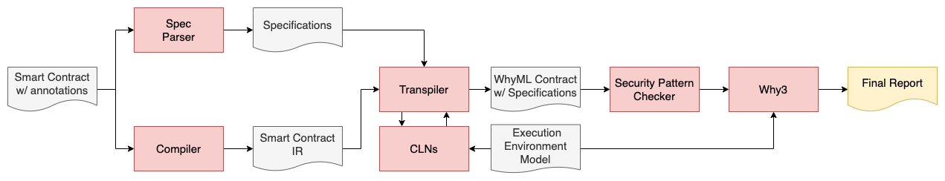
Architecture
Why3 queries

Slide 20

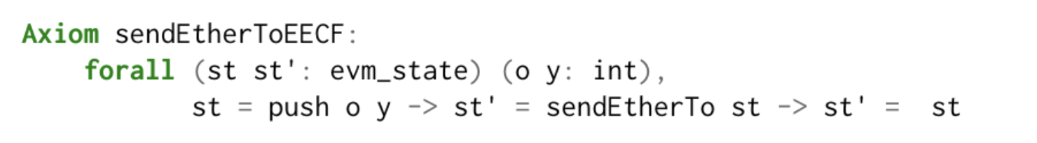
For hard-to-solve patterns, we use the following axioms to aid (taking a cut in the proof)
Storage_reduce is taking a shortcut to prove that for any virtual machine state, the read and write functions of the machine’s storage cancel each other (inverse functions)
sendEtherToEECF states that is there is a function sendEtherTo, which is an inter-contract call to another address in the blockchain, we will assume that the call is callback-free. This prevents the re-entrency attack

Slide 21
Demo Time!

